Slide 1
Data Link Layer MAC Address
Lecture 02

Slide 2
Data Link Layer (DLL) functions
Frame
The unit of data to be sent by a DLL protocol
Addressing
Identifying an entity on the DLL network
Data transfer
Medium access control
Accessing the physical medium to transmit frames
Flow control
Controlling the transmission speed of a sender
Error control
Detecting and correcting transmission errors
Management
Maintaining the data link layer

Slide 3
Identity

Slide 4

Identity
Identity
Who are you? (identifier)
Name (identifier)
Phone Number
Network Access Identifier
Email address (identifier @ address)
Where are you? (locator)
Address
Domain Names
Collins Cobuild Advanced Learner's English Dictionary 6th Edition © Harper Collins Publishers 2009
A speaker or writer uses you to refer to the person or people that they are talking or writing to.

Slide 5
Data Link Layer MAC Address
Data Link Layer Address
It is an identifier of receivers or the sender of a frame.
It is an identifier of an entity connected to the link.
It is an identifier, not a locator.
Why? The receivers are connected to the same link, so the sender knows where they are.
Multiple receivers may receive the same frame.
The destination address may be an individual, multicast or broadcast address.
The sender must be one.
The source address must be an individual (unicast) address

Slide 6
Data Link Layer MAC Address
Two types of identifiers
Two identifiers of MAC entities required for the sending frame
An Identifier used to distinguish an interface on a network device, attached to the link.
Two identifiers are usually described at the source and the destination of a frame
the identifier of the upper layer for a received frame
An identifier used to distinguish an upper layer protocol at a data link layer
It is usually prepended to the data by the LLC layer and removed by the LLC before delivering the frame to the upper layer protocol .

Slide 7
HDLC address
ISO/IEC 13239-2002

Slide 8
MAC Address ISO/IEC 13239:2002 HDLC address
ISO/IEC 13239-2002
High-level data link control (HDLC) procedures
It cancels and replaces
ISO/IEC 13239:2000
ISO/IEC 3309:1993
ISO/IEC 4335:1993
ISO/IEC 7809:1993
ISO/IEC 8885:1993

Slide 9
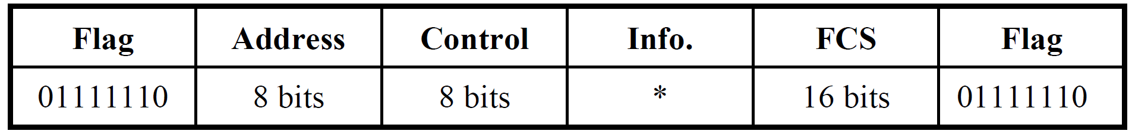
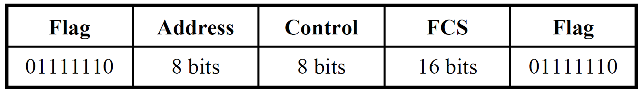
MAC Address ISO/IEC 13239:2002 HDLC address
Basic frame format
0x7E
Frames containing only control sequences

Slide 10
MAC Address ISO/IEC 13239:2002 HDLC address
Order of bit transmission
Addresses shall be transmitted low-order bit (LSB) first
bit8
bit1
E
E: Extension bit
(1) not extended
(0) extended
The order of transmission

Slide 11
MAC Address ISO/IEC 13239:2002 HDLC address
Address field(s)
Frames [using the basic frame format] shall have one address field immediately following the opening flag
A single octet address field shall normally be used and all 256 combinations shall be available.
Frames using the non-basic frame format
more than one address field
they shall be present in the frame in a consecutive manner
an extended address field consisting of one or more octets

Slide 12
MAC Address ISO/IEC 13239:2002 HDLC address
Address field(s)
In command frames, the address(es) shall identify the data station(s) for which the command is intended
In response frames, the address shall identify the data station from which the response originated

Slide 13
MAC Address ISO/IEC 13239:2002 HDLC address
Extended address field
By prior agreement, the address field range can be extended by reserving the first transmitted bit (low-order) of each address octet which would then be set to binary zero to indicate that the following octet is an extension of the address field
bit8
bit1
bit8
bit1
0
1
1 (MSB)
2 (LSB)

Slide 14
MAC Address ISO/IEC 13239:2002 HDLC address
Addressing conventions
All-station address: all 1s (0xFF) (a broadcast address)
The all-station address shall only be used with command frames
It shall instruct all receiving data stations to accept and action the associated command frame
Any response [to a command with the all-station address] shall contain the assigned individual address of the data station transmitting the response
Any responses from these data stations shall not interfere with one another
The all-station address may be used for all-station polling

Slide 15
MAC Address ISO/IEC 13239:2002 HDLC address
Addressing conventions
No-station address: all 0s (0x00)
The bit pattern 00000000 in the first octet of the extended or non-extended address field is defined as the no-station address
The no-station address shall never be assigned to a data station
The no-station address may be used for testing when it is intended that no data station react or respond to a frame containing the no-station address

Slide 16
MAC Address ISO/IEC 13239:2002 HDLC address
Addressing conventions
Group addresses (Multicast address)
One or more data stations may be assigned one or more group addresses
Any address field bit pattern, except the all-station address, the no-station address, and any individual address already assigned, may be assigned as a group address
A group address may be used for group polling

Slide 17
MAC Address ISO/IEC 13239:2002 HDLC address
HDLC address does not define the upper layer (protocol) Identifier.
It means that the HDLC requires another protocol which defines the upper layer (protocol) Identifier.
(RFC1661) The Point-to-Point Protocol (PPP)
(RFC1662) PPP in HDLC-like Framing
UI-frame
PPP frame (RFC1661)

Slide 18
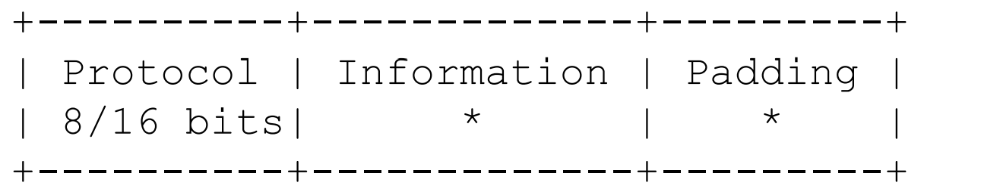
MAC Address (RFC1661) The Point-to-Point Protocol (PPP)
Protocol Field
The Protocol field is one or two octets, and its value identifies the datagram encapsulated in the Information field of the packet.
The structure of this field is consistent with the ISO 3309 extension mechanism for address fields
(8bits) xxxx xxx1, (16bits) xxxx xxx0 xxxx xxx1

Slide 19
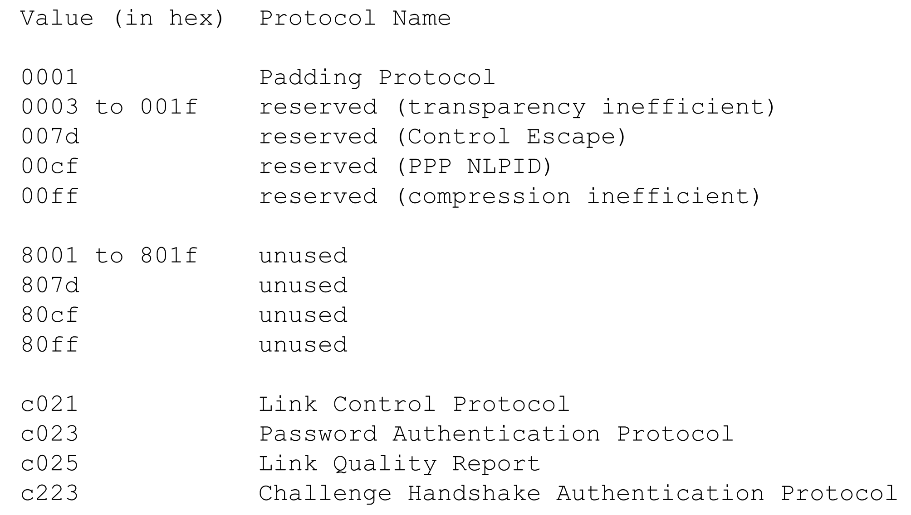
MAC Address (RFC1661) The Point-to-Point Protocol (PPP)

Slide 20
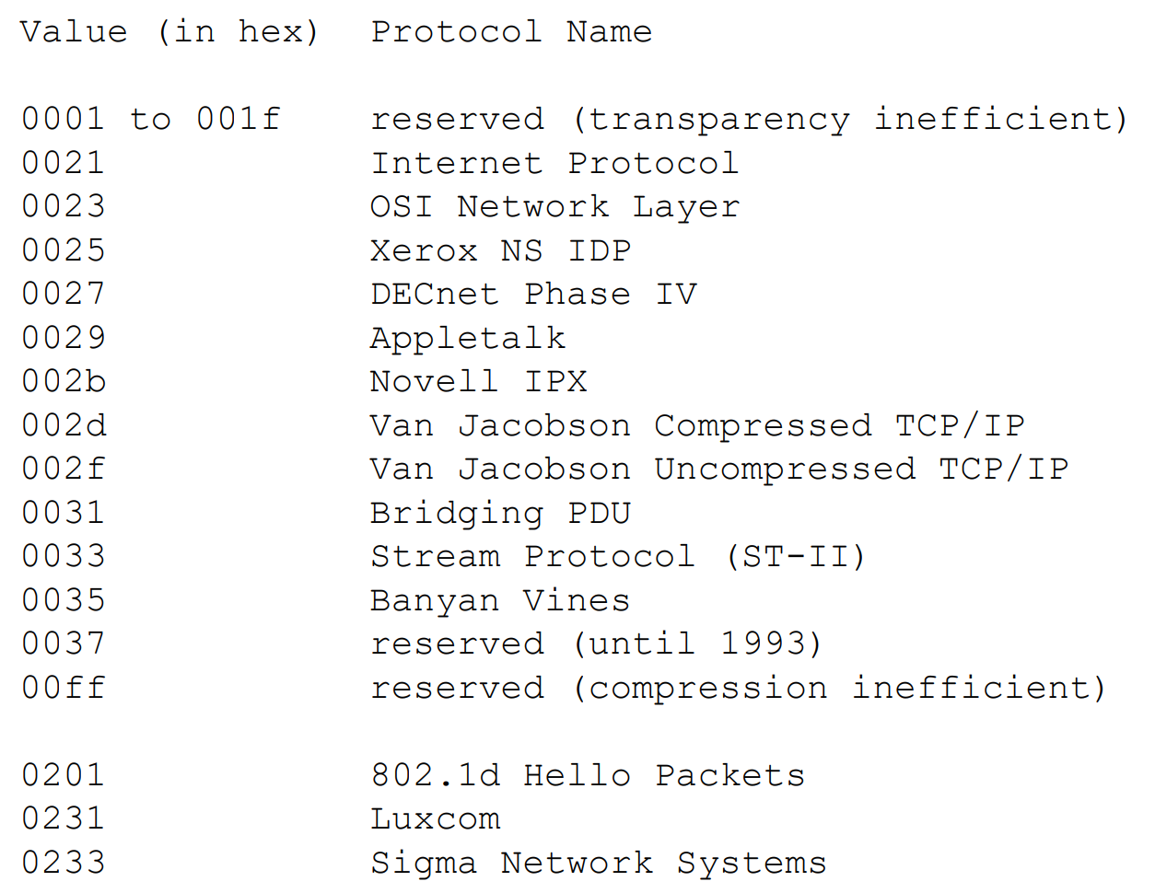
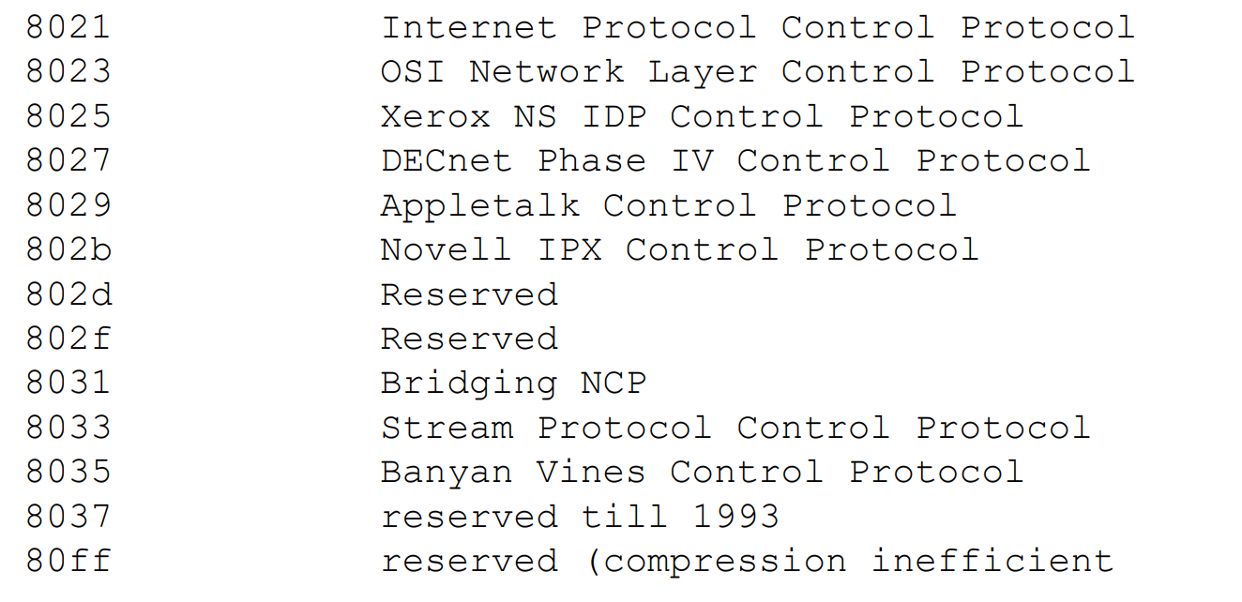
RFC1340 ASSIGNED NUMBERS PPP DLL PROTOCOL NUMBERS
Note that the last bit has always ‘1’.
The first bit
- (0) the data frame of the specified protocol (0x0021:IP)
- (1) the control frame of the specified protocol (0x8021:IPCP)

Slide 21

Original Ethernet Address
The Ethernet : A Local Area Network
Data Link and Physical Layer Specification
Version 2, 1982.11

Slide 22
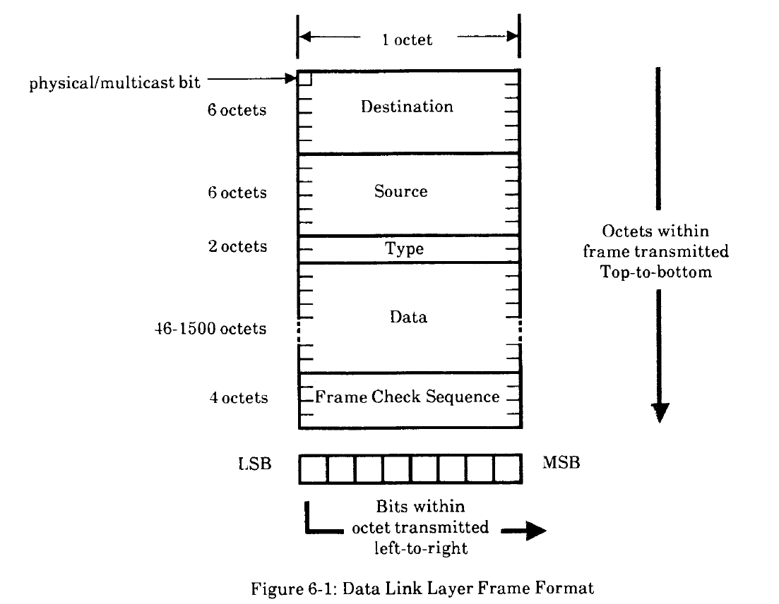
MAC Address Ethernet II (or DIX) frame format

Slide 23
MAC Address Ethernet II (or DIX) frame format
Address Field (Ethernet II, Section 6.2.1)
The first bit of a data link address distinguishes physical from multicast addresses: (I/G bit or M bit)
0 => physical address, 1 => multicast address
Human-readable form (hexadecimal form)
12 hexadecimal digits with the digits paired in groups of 2.
These digit pairs (representing octets) shall be separated by single hyphens.
The order of transmission on the Ethernet (bit-reversed from)
The leftmost octet (as written or displayed) to the rightmost octet.
From the least significant bit of the rightmost digit to the most significant bit of the leftmost digit within an octet (two digits).

Slide 24
MAC Address Ethernet II (or DIX) frame format
Address Field (Ethernet II, Section 6.2.1)
Example
F0-2E-15-6C-77-9B
Hexadecimal format (separated by single hyphens(-))
1111 0000 - 0010 1110 …
Transmission order (separated by single colons(:))
0F:2E:…
0000 1111 : 0111 0100 …..

Slide 25
MAC Address Ethernet II (or DIX) frame format
Type Field (Ethernet II, Section 6.2.2)
The type field consists of a two-octet value reserved for use by higher levels to identify the Client Layer protocol associated with the frame.
The type field is uninterpreted at the Data Link Layer

Slide 26
MAC Address Ethernet II (or DIX) frame format
Address and Type Assignment (Ethernet II, Appendex B)
The procedures for assigning unique values for physical and multicast addresses.
The address and type fields will be administered by Xerox Corporation
An address may be represented as a string of six octets, A-B-C-D-E-F.
The least significant bit of the first octet, A, is the multicast bit.
The numbers A-B-C are assigned by the Ethernet Address Administration Office at the above address.
The remaining octets, D-E-F are assigned locally by the organization assigned the blocks identified by A-B-C.

Slide 27
MAC Address
IEEE 802-2014 Addresses

Slide 28
MAC Address IEEE 802-2014 address
Three types of identifiers are defined
Interface Address
Clause 8 MAC Addresses
Protocol identifiers
Clause 9 Protocol Identifiers
Managed Object IDentifier (type identifiers of MIB)
Clause 10 Allocation of OID values in IEEE 802 standards

Slide 29
MAC Address IEEE Registration Authority
IEEE-SA - Registration Authority
Your trusted source for acquiring MAC Addresses and Unique Identifiers
https://standards.ieee.org/products-services/regauth/index.html

Slide 30
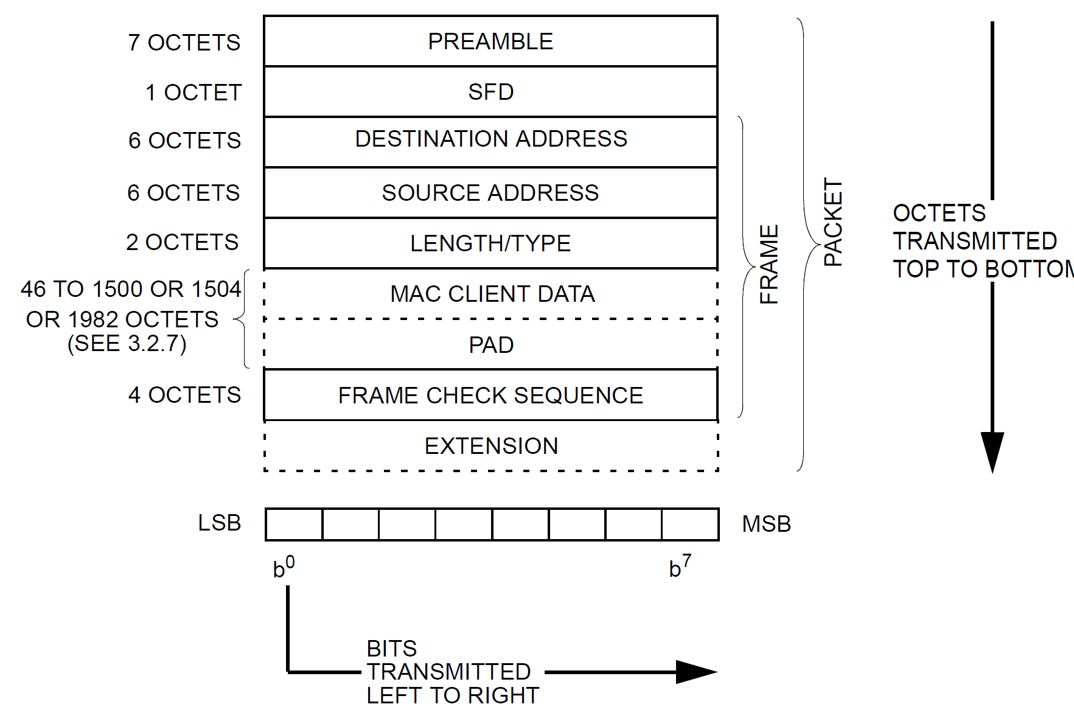
MAC Address IEEE 802.3-2022 Ethernet Frame

Slide 31
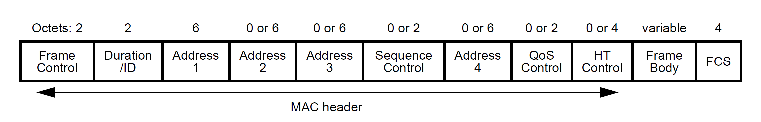
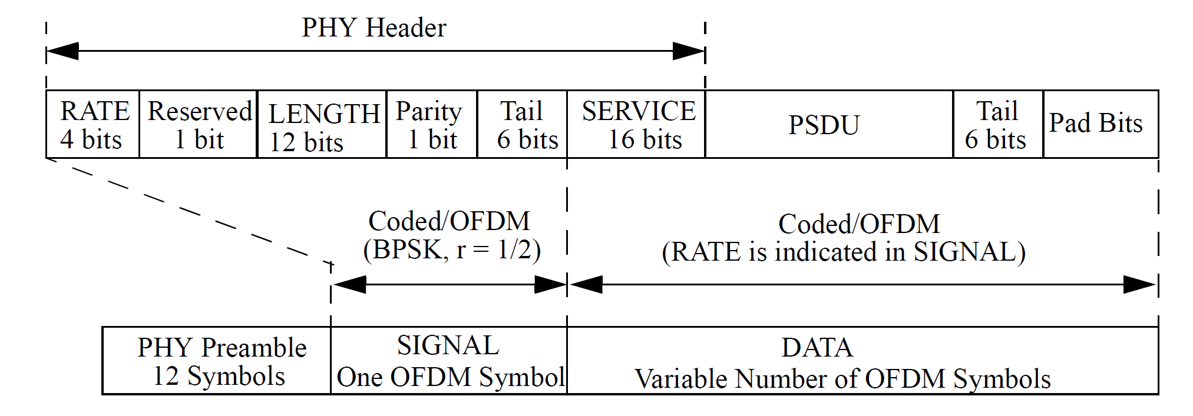
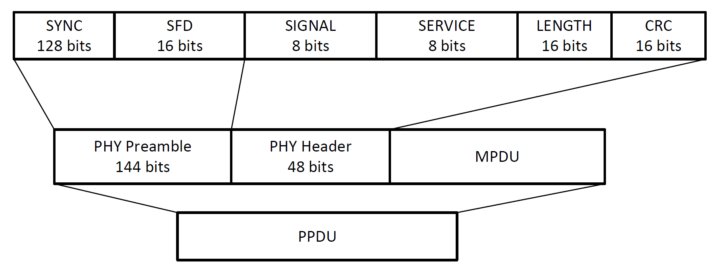
MAC Address IEEE 802.11-2020 WLAN MAC Frames
LLC SNAP frame
OFDM (11a/g/n/ac) Physical Layer Frame
DSSS (11b) Physical Layer Frame

Slide 32
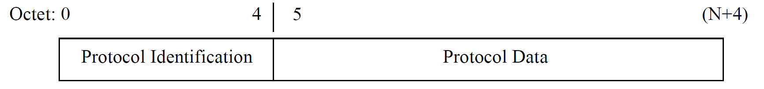
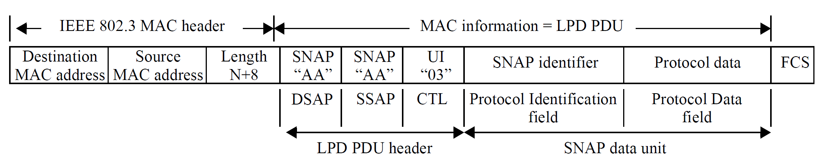
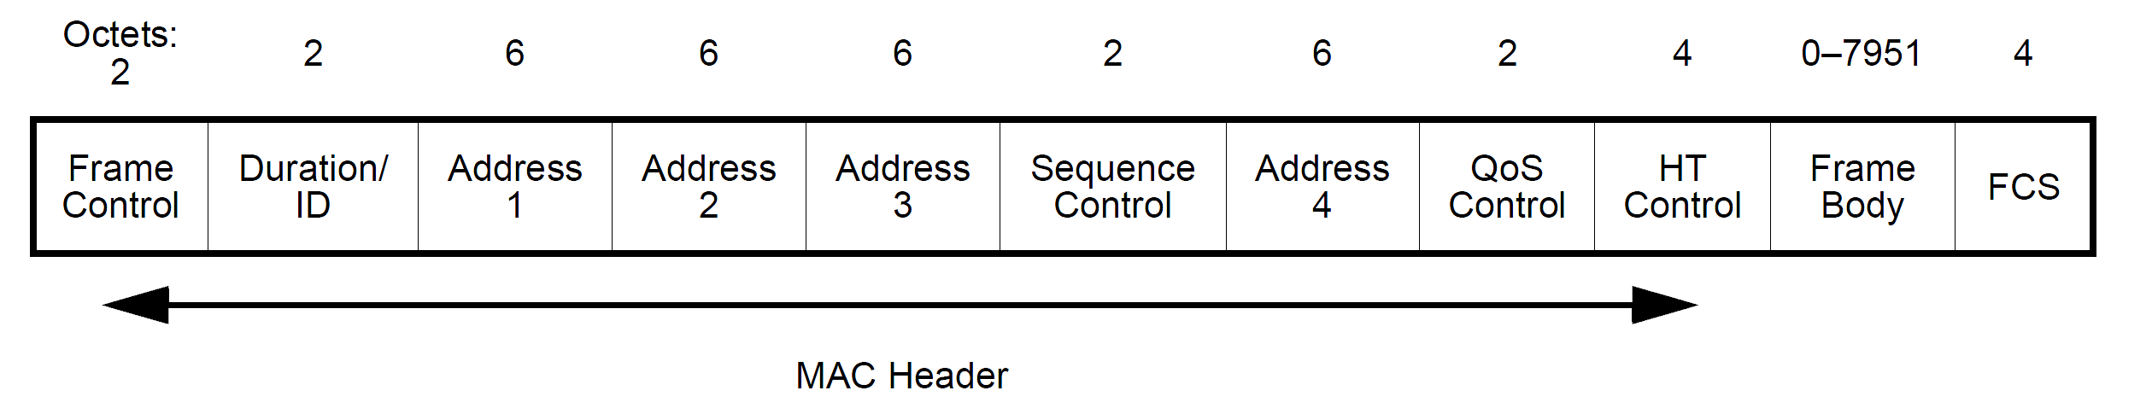
MAC Address IEEE 802-2014 Protocol identifiers Encapsulation of Ethernet frames with LPD
Protocol Identifier fields (5octets)
OUI(3octets)+Ethertype(2octets)
IEEE 802.11: (000000)+Ethertype
IEEE 802.11

Slide 33
MAC Address IEEE 802-2014 MAC address
MAC address
It is used to refer to a 48-bit or 64-bit number that is used to identify the source and destination MAC entities
MAC address: a 48-bit MAC address
Extended address: a 64-bit (EUI-64) or 48-bit (EUI-48) address
EUI: Extended Unique Identifier (X bit of first octet of the OUI :0)
xxxx xxXM, X: Universal/Local bit, M: Individual/Group bit
ELI: Extended Local Identifier (X bits of first octet of the OUI :1)
It may also be used to identify peer MAC entities.

Slide 34
MAC Address IEEE 802-2014 MAC address
If interoperability through bridges (IEEE802.1Q/1D) is required for a standard, then 48-bit MAC addressing is required.
New standards [that only require routed connectivity] should use 64-bit MAC addressing.
IEEE 802.15.4 uses 64-bit MAC addressing

Slide 35
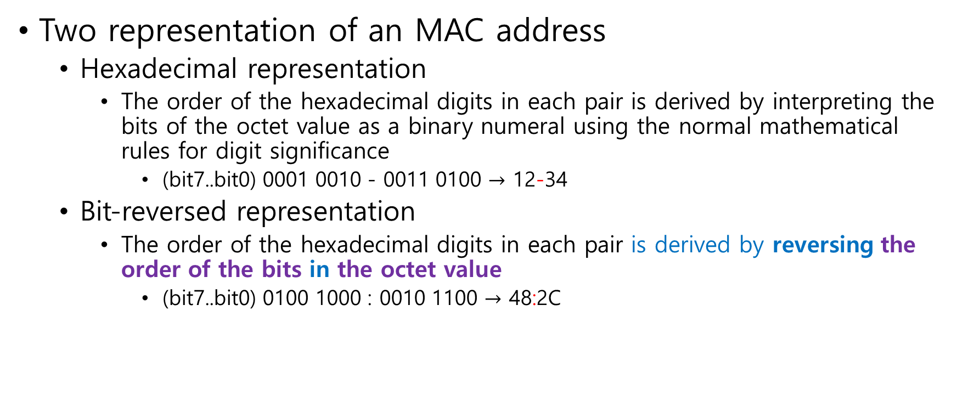
MAC Address IEEE 802-2014 MAC address
Two representation of an MAC address
Hexadecimal representation
The order of the hexadecimal digits in each pair is derived by interpreting the bits of the octet value as a binary numeral using the normal mathematical rules for digit significance
(bit7..bit0) 0001 0010 - 0011 0100 $→$ 12-34
Bit-reversed representation
The order of the hexadecimal digits in each pair is derived by reversing the order of the bits in the octet value
(bit7..bit0) 0100 1000 : 0010 1100 $→$ 48:2C

Slide 36
MAC Address IEEE 802-2014 address
Universal addresses
The concept of universal addressing is based on the idea that all potential members of a network need to have a unique identifier.
A universal address is a MAC address that is globally unique

Slide 37
MAC Address IEEE 802-2014 address
Two different lengths of universal addresses
(the IEEE Registration Authority (RA))
48-bit extended unique identifier (EUI-48)
64-bit extended unique identifier (EUI-64)

Slide 38
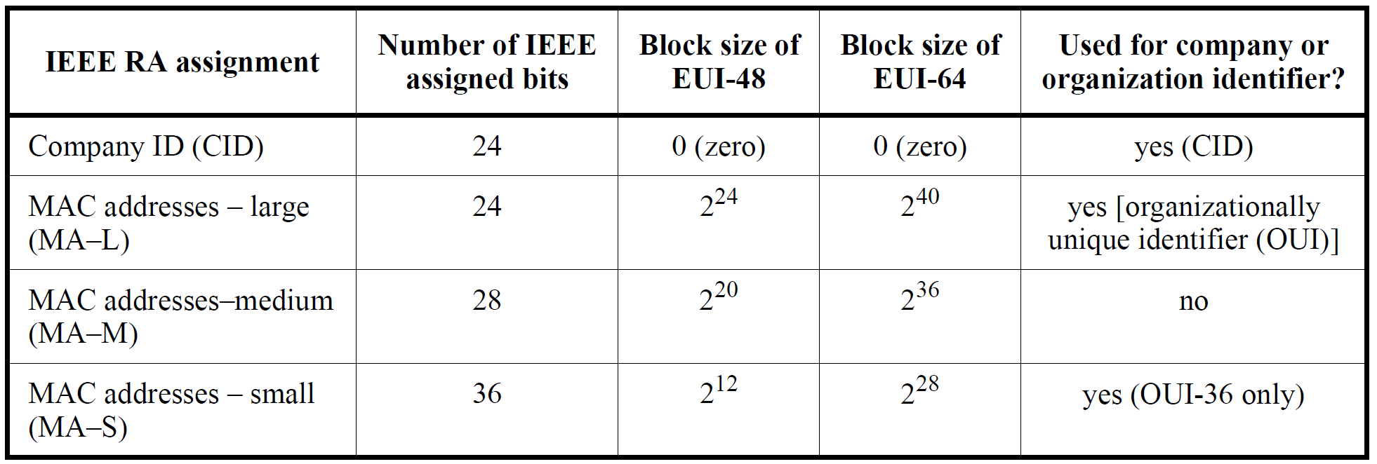
MAC Address IEEE 802-2014 address
IEEE RA assignment summary
OUI (24)
Local ID (24)
OUI (24)
Local ID (40)
The standard representation of MA-L, MA-M, and MA-S is to use the hexadecimal representation

Slide 39
MAC Address Ethernet Address and IEEE 802-2014 address Schemes
The original IEEE 802 MAC address comes from the original Xerox Ethernet addressing scheme
The term MAC-48 is now obsolete.
It was used to address hardware interfaces within existing 802-based networking applications
The term EUI-48 was historically used to identify a design instance, as opposed to a hardware interface.
It includes software interface standards (such as VGA), the model number for a product, and the form/function of vendor-specific content.
The subtle difference between MAC-48 and EUI-48 was not well understood, so the term EUI-48 is now used for both uses, and the term MAC-48 identifier is now obsolete.

Slide 40
MAC Address IEEE 802-2014 address Organization Unique Identifier (OUI)
Globally Unique Identifier
How?
Global Unique Identifier + Local Identifier
Global ID = Organization Unique Identifier (OUI)
It is assigned by IEEE-SA.
https://standards-oui.ieee.org/
64-1B-2F (hex) Samsung Electronics Co.,Ltd (0110 0100)
641B2F (base 16) Samsung Electronics Co.,Ltd
#94-1, Imsoo-Dong, Gumi Gyeongbuk 730-350, KR
9C-73-B1 (hex) Samsung Electronics Co.,Ltd (1001 1100)
9C73B1 (base 16) Samsung Electronics Co.,Ltd
#94-1, Imsoo-Dong, Gumi Gyeongbuk 730-350, KR
38-8A-06 (hex) Samsung Electronics Co.,Ltd (0011 1000)
388A06 (base 16) Samsung Electronics Co.,Ltd
#94-1, Imsoo-Dong, Gumi Gyeongbuk 730-350, KR

Slide 41
MAC Address IEEE 802-2014 address Organization Unique Identifier (OUI)
Organizationally Unique Identifiers (OUIs)
The IEEE makes it possible for organizations to employ unique individual LAN MAC addresses, group addresses, and protocol identifiers
24 bits (OUI) or 36 bits (OUI-36)

Slide 42
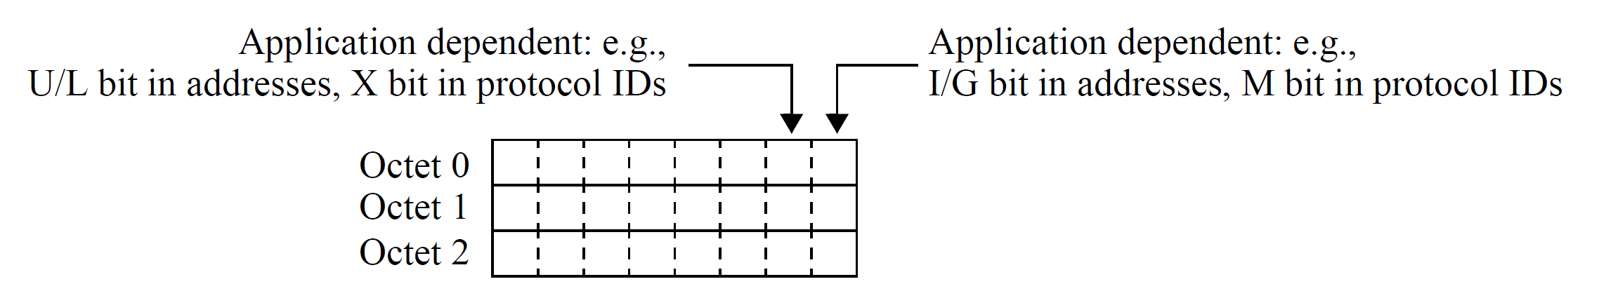
MAC Address IEEE 802-2014 address Organization Unique Identifier (OUI)
MSB
LSB
The structures for the first octet of OUI and OUI-36 are the same
(M bit) the least significant bit (LSB) of the first octet is the individual/group (I/G) address bit
(X bit) The next-to-LSB of the first octet for the assignment is the universal/local (U/L) address bit

Slide 43
MAC Address IEEE 802-2014 address Organization Unique Identifier (OUI)
The I/G address (M) bit is used to identify the destination MAC address as an individual MAC address or a group MAC address.
The all-stations broadcast MAC address is a special group MAC address of all 1’s.

Slide 44
MAC Address IEEE 802-2014 address Organization Unique Identifier (OUI)
The U/L bit indicates whether the MAC address has been assigned by a local or universal administrator.
(U/L=0) Universal address (Extended Unique Identifier (EUI))
(U/L=1) Local Address (Extended Local Identifier (ELI))
All bits [except the I/G (X) and U/L (M) bits] are locally administered
It should not be expected to meet the uniqueness requirement of the IEEE RA-assigned values

Slide 45
MAC Address IEEE 802-2014 address Extended Unique Identifier (EUI)
A universal address (or EUI) consists of two parts:
The leading bits (24, 28, or 36) are assigned by the IEEE RA with the U/L bit (X) set to zero
The remaining bits by that assignee

Slide 46
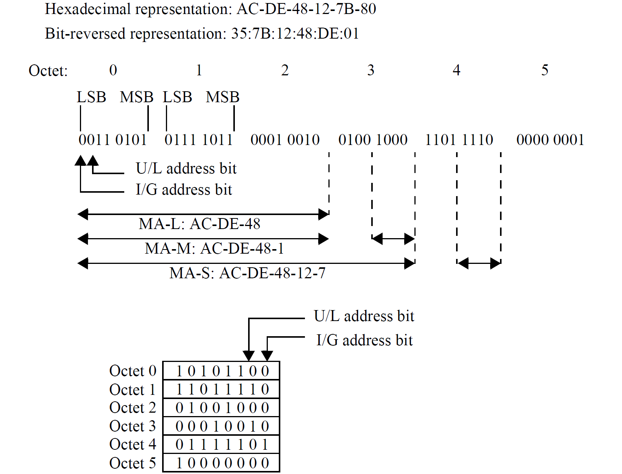
MAC Address IEEE 802-2014 address Extended Unique Identifier (EUI)
Bit-reversed representation
most significant bit (MSB)
Least significant bit (LSB)
OUI-24
OUI-28
OUI-36
Hexadecimal representation

Slide 47
MAC Address IEEE 802-2014 address Extended Unique Identifier (EUI)
Interworking with 48-bit and 64-bit MAC addresses
Initially, new IEEE standards projects [that did not require backward compatibility with EUI-48] were requested to use 64-bit MAC addresses.
Bridging for an IEEE 802 network with 64-bit MAC addresses is currently not specified.
Traffic between 64-bit and 48-bit MAC addressed networks needs to be routed at a layer (a network layer) above the DLL.

Slide 48
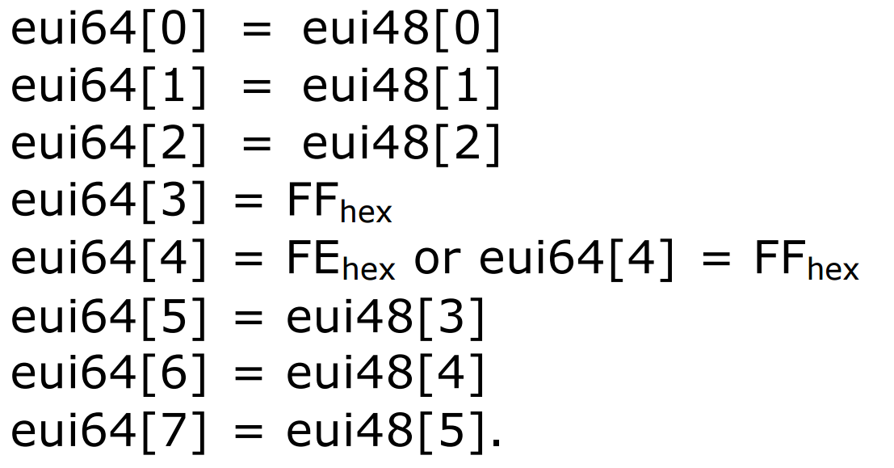
MAC Address Guidelines for Use of EUI, OUI, and CID (2017-08-03) https://standards.ieee.org/wp-content/uploads/import/documents/tutorials/eui.pdf
Mapping an EUI-48 to an EUI-64 (deprecated)

Slide 49
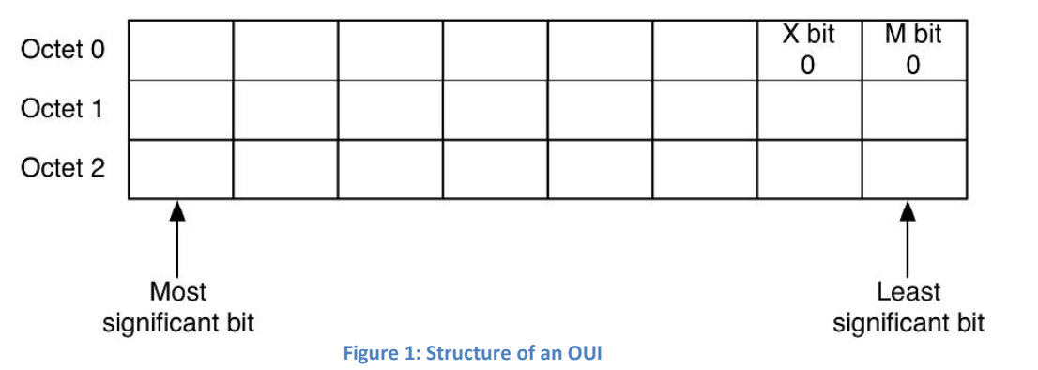
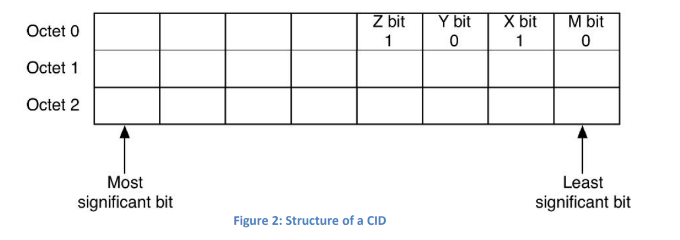
MAC Address Guidelines for Use of EUI, OUI, and CID (2017-08-03) https://standards.ieee.org/wp-content/uploads/import/documents/tutorials/eui.pdf
Fixed value
CID Company ID

Slide 50
MAC Address Guidelines for Use of EUI, OUI, and CID (2017-08-03) https://standards.ieee.org/wp-content/uploads/import/documents/tutorials/eui.pdf
Extended Local Identifier (ELI)
An Extended Local Identifier (ELI) is created by concatenation from a Company ID (CID), which comprises the initial three (most significant) octets.
ZYXM:(1010 (A)) X(U/L)=1, M(I/G)=0; ELI-48 ELI-64
An ELI is a local address
Local addresses are not globally unique, and
A network administrator is responsible for assuring that any local addresses assigned are unique within the span of use
It may assign M(I/G) bit

Slide 51
MAC Address Guidelines for Use of EUI, OUI, and CID (2017-08-03) https://standards.ieee.org/wp-content/uploads/import/documents/tutorials/eui.pdf
Structured Local Address Plan (SLAP)
IEEE Std 802c-2017 specifies the SLAP, which describes the use of ELIs in one quadrant of local MAC address space, based on the specified values of the CID (ZYXM:1010 (A)).
(ZYXM:1010) ELI (CID)
In other quadrants of local MAC address space, the SLAP describes the use of Standard Assigned Identifiers (SAIs) and Administratively Assigned Identifiers (AAIs) not based on a CID.
(ZYXM:1110 (E)) Standard Assigned Identifier (SAI)
Reserved for the standard forthcoming from IEEE P802.1CQ: Multicast and Local Address Assignment
(ZYXM:0010 (2)) Administratively Assigned Identifier (AAI)
The local MAC addresses in an arbitrary fashion (random)
(ZYXM:0110 (6)) Reserved

Slide 52
MAC Address Standard Group MAC Addresses: A Tutorial Guide https://standards.ieee.org/wp-content/uploads/import/documents/tutorials/macgrp.pdf
All MAC protocol data units contain addressing information.
The addressing information consists of two fields: the destination MAC address and the source MAC address.
Both of these address fields are 48-bit fields;
The structure and semantics of the address field are defined in ISO/IEC 10039.

Slide 53
MAC Address Standard Group MAC Addresses: A Tutorial Guide https://standards.ieee.org/wp-content/uploads/import/documents/tutorials/macgrp.pdf
Standard Group MAC Addresses are MAC addresses that have been allocated for use by standard protocols and consist of the following four sets of MAC Group Addresses:
IEEE 802.1D MAC Bridge Filtered MAC Group Addresses,
Standard MAC Group Addresses,
MAC Group Addresses used in ISO 9542, and
End system to Intermediate system routing exchange protocol for use in conjunction with the Protocol for providing the connectionless-mode network service (IS0 8473)
Token Ring LAN Functional Addresses.

Slide 54
MAC Address Standard Group MAC Addresses: A Tutorial Guide https://standards.ieee.org/wp-content/uploads/import/documents/tutorials/macgrp.pdf
IEEE 802 OUI (0X-80-C20)
0X-80-C2-00-00-00 to 0X-80-C2-FF-FF-FF
X(hexadecimal value): 0 for individual addresses, and 1 for group addresses.
IEEE 802.1D MAC Bridge Filtered MAC Group Addresses
01-80-C2-00-00-00 to 01-80-C2-00-00-0F
Standard MAC Group Addresses
01-80-C2-00-00-10 to 01-80-C2-FF-FF-FF
MAC Group Addresses used in ISO 9542
09-00-2B-00-00-04 and 09-00-2B-00-00-05

Slide 55
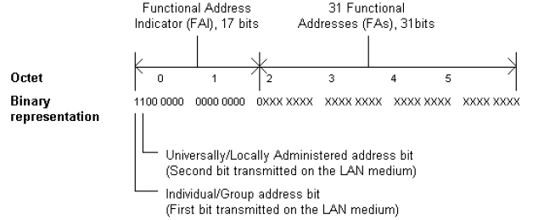
MAC Address Standard Group MAC Addresses: A Tutorial Guide https://standards.ieee.org/wp-content/uploads/import/documents/tutorials/macgrp.pdf
Token Ring LAN Functional Addresses
Due to limitations in existing intermediate systems and end systems that implement IEEE 802.5.
It is necessary to allocate several "functional addresses“ that correspond to Standard Group MAC Addresses for use with ISO 9542 when operating on an IEEE 802.5 LAN.
(Bit-reversed representation)
Figure 2 - Representation of Token Ring LAN Functional Addresses
- Functional Addresses are defined in ISO/IEC 8802-5
(ISO/IEC 8802-5 Token ring access method and physical layer specifications)

Slide 56
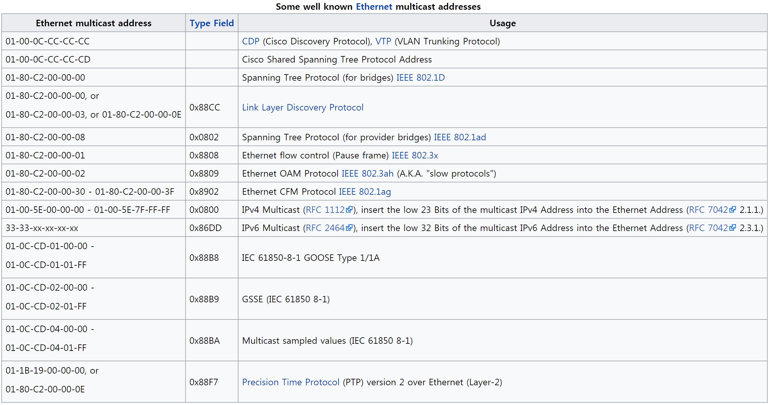
MAC Address Standard group MAC addresses
https://en.wikipedia.org/wiki/Multicast_address

Slide 57
Protocol Identifiers
IEEE 802-2014 Addresses

Slide 58
Data Link Layer IEEE 802-2014 Protocol identifiers
For multiple protocols to coexist within a layer, it is necessary to determine which protocol is to be invoked to process a service data unit (SDU) delivered by the lower layer.

Slide 59
Data Link Layer IEEE 802-2014 Protocol identifiers
Protocol Identifiers
LLC Protocol Discrimination (LPD)
EtherType Protocol Discrimination (EPD)
It is based on EtherTypes

Slide 60
Data Link Layer IEEE 802-2014 Protocol identifiers
EtherTypes
EtherType was first defined by the Ethernet II framing standard
DIX Ethernet, named after DEC, Intel and Xerox
It was later adapted for the IEEE 802.3 standard
Ethertype protocol identification values are assigned by the IEEE RA
https://regauth.standards.ieee.org/standards-ra-web/pub/view.html#registries

Slide 61
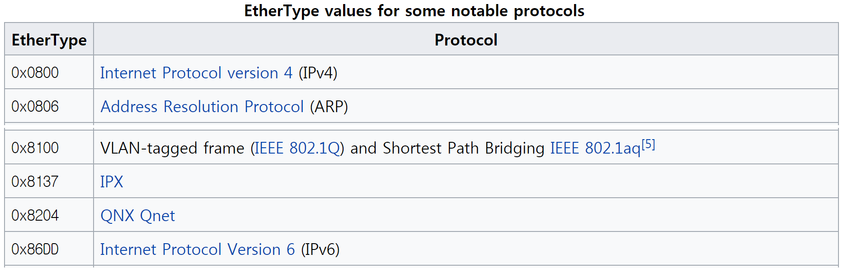
Data Link Layer IEEE 802-2014 Protocol identifiers
Ethertype
A 16-bit numeric value with the first octet containing the most significant 8 bits and the second octet containing the least significant 8 bits

Slide 62
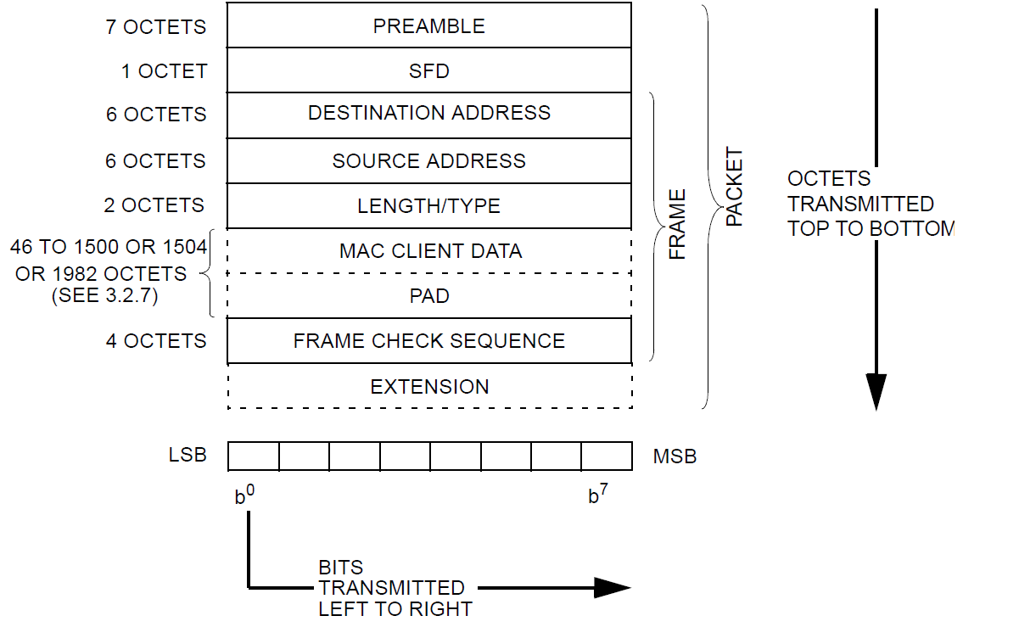
Data Link Layer IEEE 802-2014 Protocol identifiers
EtherType
Values in the 0–1535 (0x0000-0x05FF) range are not available for use in order to retain legacy compatibility with Length field based protocols.
Length field for IEEE 802.3 CDMA/CD format

Slide 63
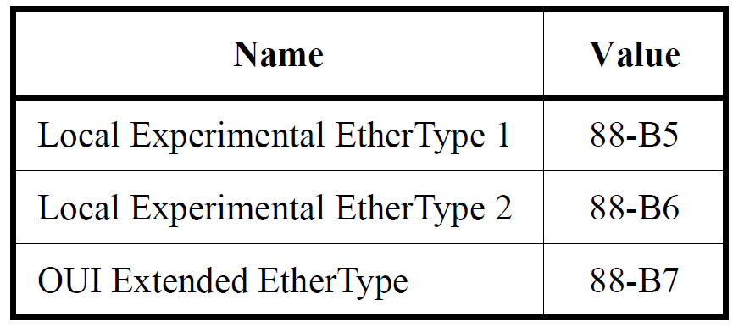
Data Link Layer IEEE 802-2014 Protocol identifiers
EtherTypes for prototype and vendor-specific protocol development
It is strongly recommended when designing new protocols to be identified by an EtherType, that fields are defined to provide for subtyping.
Two EtherType values
the Local Experimental EtherTypes
A single EtherType value
the OUI Extended EtherType

Slide 64
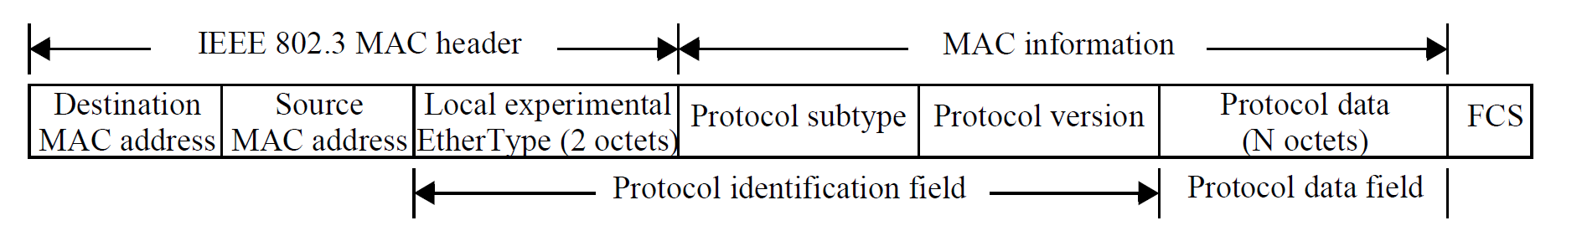
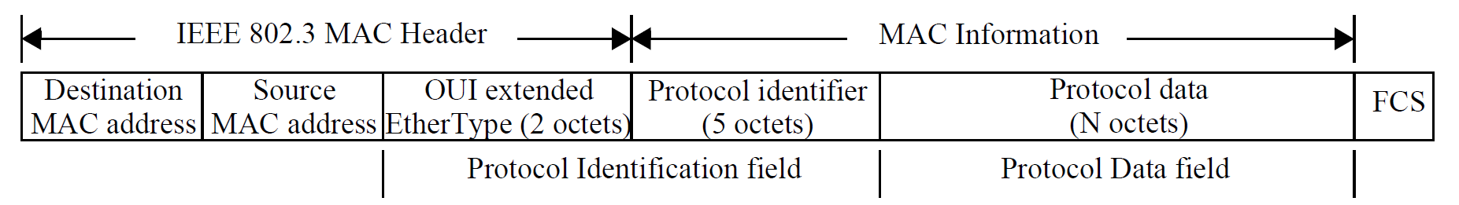
Data Link Layer IEEE 802-2014 Protocol identifiers

Slide 65
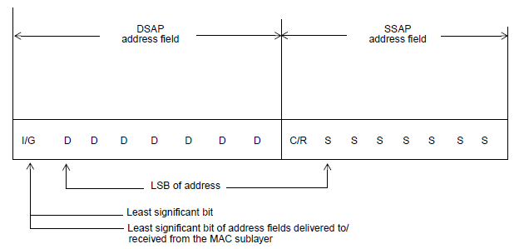
Data Link Layer (RFC1042) A Standard for the Transmission of IP Datagrams over IEEE 802 Networks
A Standard for the Transmission of IP Datagrams over IEEE 802 Networks
Sub-Network Access Protocol (SNAP) extends LLC header.
SNAP provides a method for multiplexing and demultiplexing of private and public protocols among multiple users of the LLC sublayer
LLC defines the LSAP of the SNAP
Decimal (170); 0xAA
LSAP : 1010 1010
I/G=0, C/R=0

Slide 66
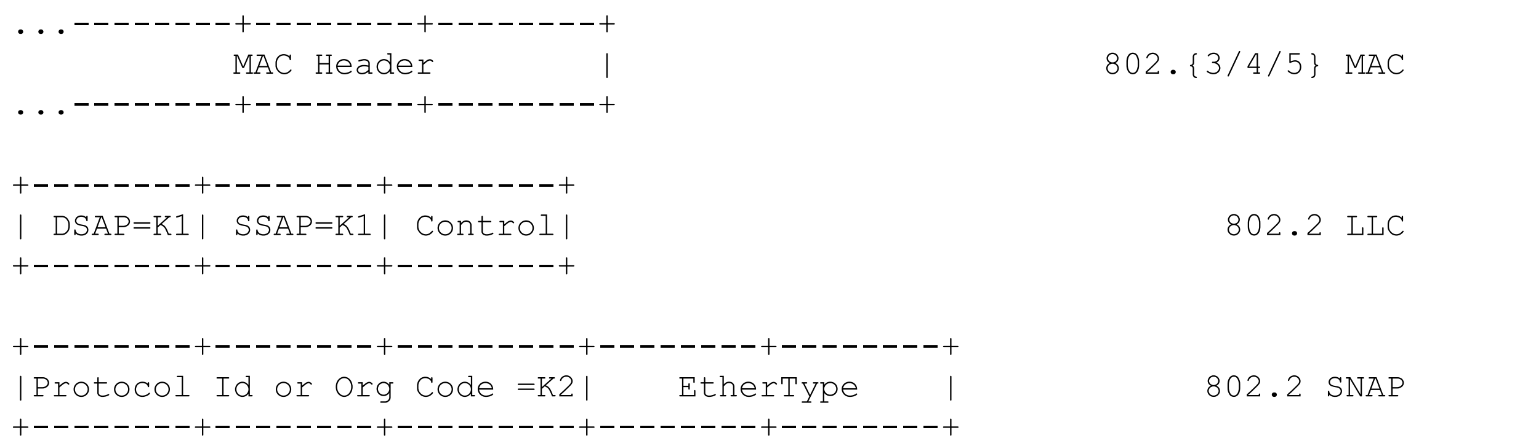
Data Link Layer (RFC1042) A Standard for the Transmission of IP Datagrams over IEEE 802 Networks
K1= 0xAA (decimal 170), Control=UI-frame (0x03), K2=0x000000
LLC header (3 octets) : DSAP | SSAP | Control
0xAAAA03
SNAP Protocol Identification (5 octets): OUI (3 octets) & Ethertype (2 octets)
0x000000 | Ethertype

Slide 67
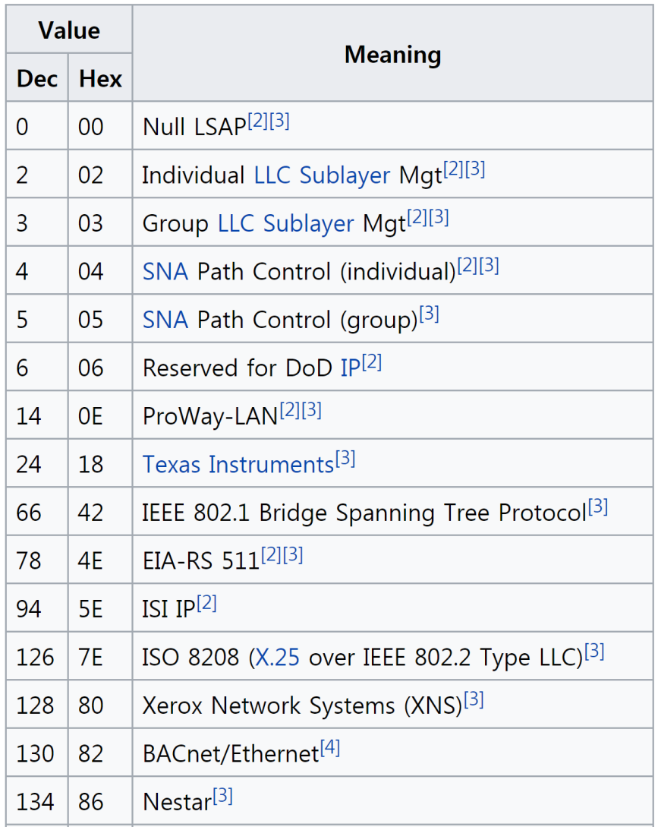
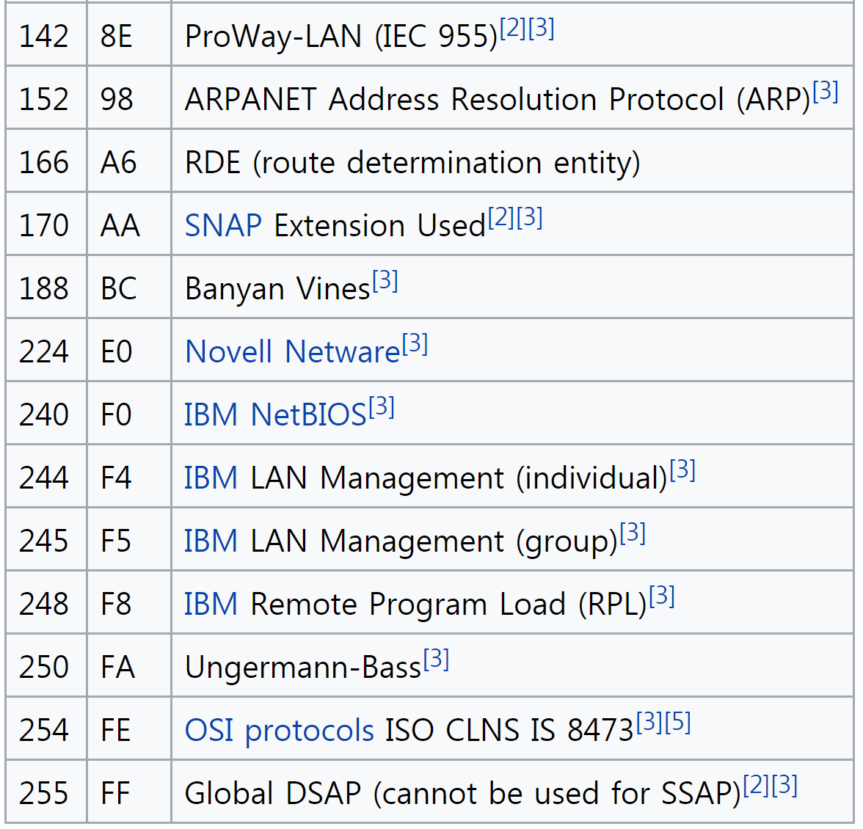
Data Link Layer DLL Address : Assigned LLC address (ISO/IEC 8802-2)
https://en.wikipedia.org/wiki/IEEE_802.2

Slide 68
Data Link Layer IEEE 802-2014 Protocol identifiers
Encapsulation of Ethernet frames with LPD
(mapping Ethernet frame to IEEE 802.11 frame)
An Ethernet frame conveyed on an LPD-only IEEE 802 network shall be encapsulated in a SNAP data unit contained in an LPD PDU of type UI-frame
The Protocol Identification field of the SNAP data unit
The three OUI octets each take the value zero
The two remaining octets take the values of the 2 octets of the Ethernet frame’s EtherType.
The values of the Destination MAC Address field and Source MAC Address field of the Ethernet frame shall be used in the Destination MAC Address field and Source MAC Address field, respectively, of the MAC frame in which the SNAP data unit is conveyed
LPD(LLC Protocol Discrimination)

Slide 69
Data Link Layer IEEE 802-2014 Protocol identifiers Encapsulation of Ethernet frames with LPD
IEEE 802.11

Slide 70
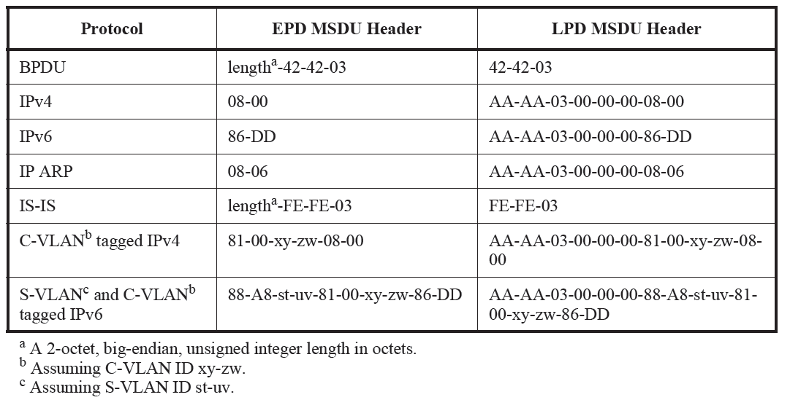
IEEE Std 802.11-2020 & IEEE Std 802.11ax-2021 Annex M (informative) EPD and LPD headers and the integration function
Table M-1—EPD and LPD MSDU headers
No EtherType is allocated
They use 802.3/LLC format
LLC Header (3octets): DSAP | SSAP | CTL,
DSAP/SSAP (0xAA): Subnetwork Access Protocol
CTL (0x03) : Unnumbered Information Frame
SNAP Header (5octets): OUI (3octets) | EtherType (2octects)

Slide 71
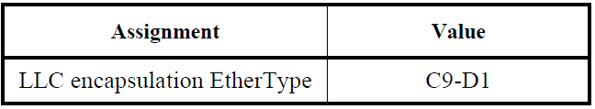
IEEE Std 802.1AC-2016 12. Protocol discrimination and media
Without the LLC encapsulation EtherType, the Length of an indication with more than 1500 octets of data might be mistaken for an EtherType.
Table 12-2—LLC encapsulation EtherType

Slide 72
IEEE Std 802.1AC-2016 12. Protocol discrimination and media 12.1 M_UNITDATA.request data transformation for LPD media
Let value_two be the value of the first two octets of the mac_service_data_unit.
a) If value_two is in the range hexadecimal 0000–05DC (decimal 0–1500) inclusive, then they constitute a Length field. In that case:
1) The Length field is removed from the mac_service_data_unit, reducing its size by 2 octets;
2) If the value of the (removed) Length field is less than the number of octets remaining in the mac_service_data_unit, then the mac_service_data_unit is further truncated, from its last octets, to the length in the Length field.

Slide 73
IEEE Std 802.1AC-2016 12. Protocol discrimination and media 12.1 M_UNITDATA.request data transformation for LPD media
b) Otherwise, if value_two is equal to the LLC encapsulation EtherType (C9D1), then those two octets are removed from the mac_service_data_unit.
c) Otherwise, if value_two is in the range hexadecimal 0600–FFFF (decimal 1536–65535) inclusive, then they constitute an EtherType.
In that case, the six octets hexadecimal AA-AA-03-00-00-00 are inserted into the mac_service_data_unit before that EtherType, increasing its length by six octets.
d) This standard does not specify the behavior when value_two is in the range hexadecimal 05DD–05FF (decimal 1501–1535) inclusive.

Slide 74
IEEE Std 802.1AC-2016 12. Protocol discrimination and media 12.2 M_UNITDATA.indication data transformation for LPD media
a) If the first six octets of the data parameter are hexadecimal AA-AA-03-00-00-00, then those six octets are removed from the data parameter to form the mac_service_data_unit, thus reducing its size by 6 octets.
b) Otherwise, if the length of the data parameter is in the range hexadecimal 0000–05DC inclusive, then that length is prepended to the data as a 16-bit binary integer (with the first octet being the most significant), to form the ISS mac_service_data_unit (EPD).
c) Otherwise, the LLC encapsulation EtherType is prepended to the data parameter to form the ISS mac_service_data_unit.

Slide 75
Summary

Slide 76
Data Link Layer Identifiers
The data link layer provides node-to-node data transfer between two directly connected nodes.
Node
Node
data
Is it a node or an interface?
A data link layer of a node is an interface
Which protocol asks the interface sends the data?
Which interface sends the data?
Which interface must receive the data?
The sender must provide this information to its peer (receiver).
How does the sender give the information to its peer?
How does the peer interface identify this information when it sees a frame at the link?
Node
Multihomed device
Multiple interfaces at a device

Slide 77
Data Link Layer Identifiers
Answer
The frame header
The sender (interface) address field
The receiver (interface) address field
The protocol identifier field
Note that an interface represents the data link layer

Slide 78
Point-to-Point Protocol (PPP) with High-Level Link Control (HDLC)
HDLC
Command
The frame header
The sender (interface) address field
The receiver (interface) address field (0xFF: all stations)
The protocol identifier field
Response
The frame header
The sender (interface) address field
(0xFF: all stations; The sender cannot have the broadcast address (???))
The receiver (interface) address field
The protocol identifier field
PPP
Point-to-point link
both entities know Implicitly each other (no address required)
The frame header
The protocol field

Slide 79
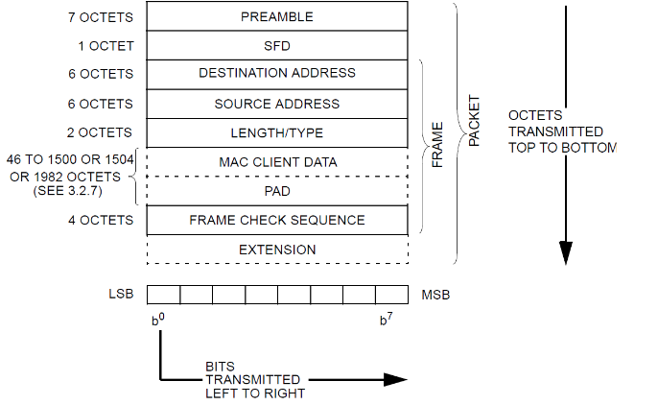
IEEE 802.3 Ethernet
Destination MAC interface
EUI-48: OUI (24bits)+Interface ID(24bits)
Source MAC interface
EUI-48: OUI (24bits)+Interface ID(24bits)
The M (I/G) bit of the OUI field must be zero
The Upper Layer Protocol
EtherType: IPv4(0x0800), IPv6(0x86DD)
IPv4
IPv6
IPv4
IPv6
IEEE 802.3
Ethernet
IEEE 802.3
Ethernet

Slide 80
IEEE 802.3 Ethernet
IPv4 module
IPv4 Packet
IEEE 802.3
Ethernet
DA
SA
Ethertype
(0x0800)
IPv4 Packet

Slide 81
IEEE 802.11 WLAN and IEEE 802.3
End station
Router
IPv4
IPv6
IPv4
IPv6
DLL (source) SAP
Access Point (AP)
(DSAF)
DLL (destination) SAP
LLC (LPD)
LLC (EPD)
IEEE 802.1AC
(LPD↔EPD)
IEEE 802.1AC
IEEE 802.1AC
IEEE 802.1AC
SA
IEEE 802.11
WLAN
WLAN
interface
LAN
interface
DA
IEEE 802.3
Ethernet
WLAN transmitter (TA)
WLAN receiver (RA)
FC:(To DS From DS:10), RA | TA=SA | DA

Slide 82
IEEE 802.11 WLAN
End station
The IP module provides two MAC addresses and data
Source MAC address (SA)
Destination MAC address (DA)
The WLAN interface must be associated with an AP before it sends any user data
It knows the MAC address of the AP WLAN interface
The receiver MAC address (RA)
The MAC address of the sender
The transmitter MAC address (TA)
It is duplicated with the source MAC address, so the source MAC address can be omitted
Addresses in the data frame are
Receiver MAC address (A1), Transmitter MAC address(A2), Destination MAC address (A3).

Slide 83
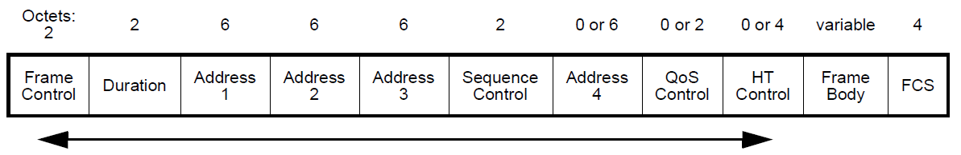
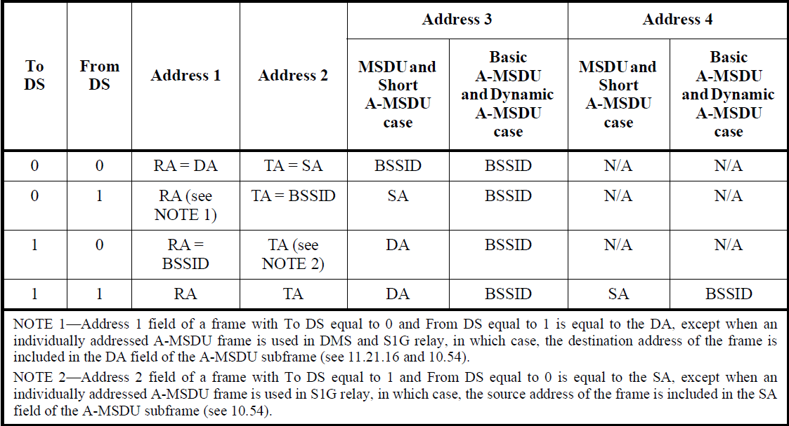
IEEE Std 802.11-2020 & IEEE Std 802.11ax-2021 9.3 Format of individual frame types 9.3.2 Data frames
Figure 9-65—Data frame format
RA=DA
TA=SA
Table 9-30—Address field contents

Slide 84
IEEE 802.11 WLAN
IEEE 802.11 MAC frame specifies the LLC/SNAP protocol
The LLC used by IEEE std 802.11 must use SNAP encapsulation (LLC/SNAP)
Source LSAP: 0xAA (SNAP), Destination LSAP: 0xAA (SNAP)
It received from the IPv4 module (Ethertype: 0x0800)
(RFC1042) A Standard for the Transmission of IP Datagrams over IEEE 802 Networks
Protocol identifier (5 octets): OUI(3octets; zero)+Ethertype(2 octets)
If OUI is not zero, then the organization having the assigned OUI value will define the semantics of the remaining bits (16bits)
DSAP
(0xAA)
SSAP
(0xAA)
Control
(0x03)
OUI
(0x000000)
Ethertype
(0x0800)
IP Packet

Slide 85
IEEE 802.11 WLAN
IPv4 module
IPv4 Packet
Mandated by IETF RFC1042
OUI
(0x000000)
Ethertype
(0x0800)
IPv4 Packet
Mandated by the IEEE 802.11 standard
LLC/SNAP
DSAP
(0xAA)
SSAP
(0xAA)
Control
(0x03)
OUI
(0x000000)
Ethertype
(0x0800)
IPv4 Packet
IEEE 802.1AC
IEEE 802.11
WLAN

Slide 86
Object Identifier
Informational
IEEE 802.2-14

Slide 87
Data Link Layer Object Identifiers (OIDs)
An OID is an identifier of an object defined by using ASN.1.
The ASN.1 defines language-independent primitive and construct types and information objects and encoding rules.
ITU-T Recommendation X.660 defines top arcs of the international object identifier tree.
It is used as a means of defining unique identifiers for objects (types).
The most common usage is for defining Management information base (MIB) Objects for SNMP
Identifiers for Managed Objects

Slide 88
ITU-T and ISO ASN.1 standards
Information technology – Abstract syntax notation one (ASN.1):
ITU-T Rec. X.680 | ISO/IEC 8824-1: Specification of basic notation
ITU-T Rec. X.681 | ISO/IEC 8824-2: Information object specification
ITU-T Rec. X.682 | ISO/IEC 8824-3: Constraint specification
ITU-T Rec. X.683 | ISO/IEC 8824-4: Parameterization of ASN.1 specifications
Information technology – ASN.1 encoding rules:
ITU-T Rec. X.690 | ISO/IEC 8825-1: Specification of Basic Encoding Rules (BER), Canonical Encoding Rules (CER) and Distinguished Encoding Rules (DER)
ITU-T Rec. X.691 | ISO/IEC 8825-2: Specification of Packed Encoding Rules (PER)
ITU-T Rec. X.692 | ISO/IEC 8825-3: Specification of Encoding Control Notation (ECN)
ITU-T Rec. X.693 | ISO/IEC 8825-4: XML encoding rules
ITU-T Rec. X.696 : Specification of Octet Encoding Rules (OER)
ITU-T Rec. X.697 : Specification of JavaScript Object Notation Encoding Rules (JER)

Slide 89
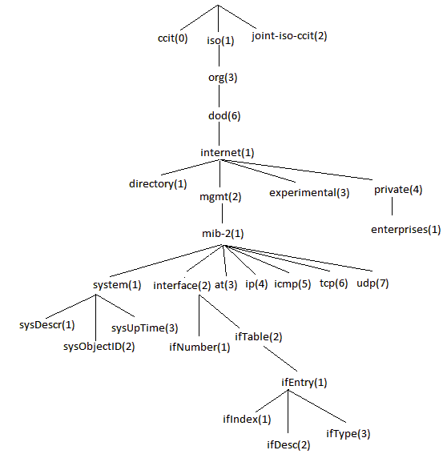
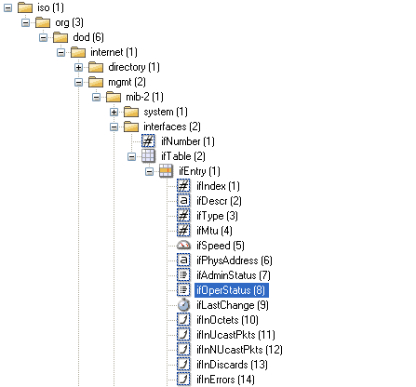
ISO/IEC 9834-1:2012 Information technology — Procedures for the operation of object identifier registration authorities — Part 1: General procedures and top arcs of the international object identifier tree X.660 : Information technology - Procedures for the operation of object identifier registration authorities: General procedures and top arcs of the international object identifier tree

